Slide 1
期末查漏补缺
新闻分享：没做的最后一次机会。
出勤记录：请核对。
书面作业：新闻采编作业，最好上课带来，最晚周日晚电子版发qq群。
阅读和微课练习：如已经补做但漏登记的，请告知。有意补做的请自行完成，并借用同学账号核对答案，告知分数（因晚交会酌情扣分）
第二课堂：听力和词汇练习15周周日晚教研室关闭通道。过时没有弥补机会
测验：请假同学申请补测。
新闻PPT展示：未完成的同学补做。

Slide 2

Lecture 15 Review
Quiz One

Slide 3
Unit 11 TEXT READING
Watching TV shortens life span, study finds----Jeannine Stein
What information can you get from the title?
How much do you know about human life span?
What kind of people do you think can live a long and healthy life? (What words or expressions come to you in terms of health and medicine?)

Slide 4
LEAD
Australian researchers (WHO)
find (WHAT)
that each hour a day spent in front of television is linked with an 18% greater risk of dying from cardiovascular disease and an 11% greater risk of all causes of death.

Slide 5
Watching television for hour upon hour obviously isn’t the best way to spend leisure time — inactivity has been linked to obesity and heart disease. But a new study quantifies TV viewing’s effect on risk of death.
This is a part introducing what is further discussed in the following paragraphs (effect ) and how (quantifies).

Slide 6
Research Paper
Title
Abstract
Introduction
Research Methodology
Results and Discussion
Conclusion

Slide 7
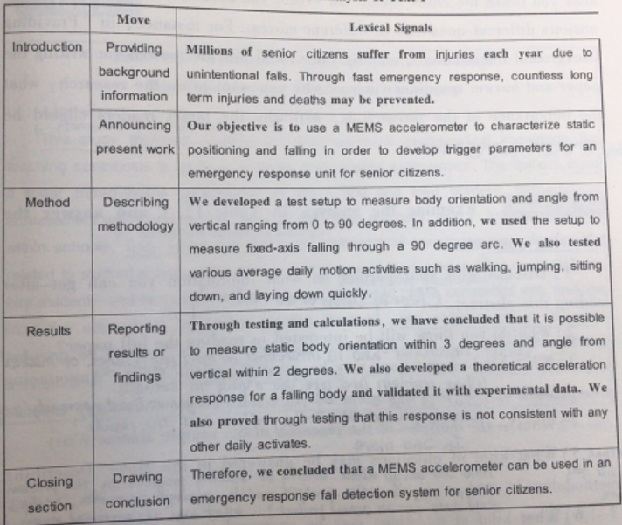
Abstract of Research Paper

Slide 8
Group work
Work in your group, and write an abstract.
Hand in your abstract at the end of the class.

Slide 9
A quantitative study on TV viewing effect on death risk
Background: para 2 as we all know, watching TV for long time which result in inactivity has been linked to obesity and heart disease. Our present study examined the quantitative effect of TV viewing on the risk of death.

Slide 10
A quantitative study on TV viewing effect on death risk
Method: para 4 and 5 We investigated 8,800 men and women older than 25 who were part of the Australian Diabetes, Obesity and Lifestyle Study. Participants recorded their television viewing hours for a week and we separated the results into three category by amount of viewing: those who watched less than two hours of TV a day, those who watch two to four hours a day ,and those who watched more than four hours a day. People who has a history of cardiovascular disease were not included.

Slide 11
Results: para 7 and para 3/1 After six-years follow-up study, researchers found that people who watched more than four hours a day showed an 80% greater risk of death from cardiovascular disease and 46% higher risk of all causes of death compared with those who watched fewer than two hours a day. The numbers were the same after the researchers controlled for smoking, high blood pressure, high cholesterol, an unhealthy diet and leisure-time exercise. It means that there was a strong connection between TV hours and death from cardiovascular disease, not just among the overweight and obese, but among people who had a healthy weight and exercised. To be exact, each hour a day spent in front of television is linked with an 18% greater risks of dying from cardiovascular disease and an 11% greater risks of all causes of death.

Slide 12
A quantitative study on TV viewing effect on death risk
Analysis: para 9 The result were not surprising because sitting posture do not using muscles and therefor it Is not able to break down glucoses and use it as an energy and finally it may trigger a spike in bold sugar levels, even leading to type 2 diabetes.
Conclusion and suggestion: Para 12/8, the research shows that irrespective of a person’s exercise level, sitting for more hours was linked to a significant increase in risk of death. Therefore, the physical activity over a 24-hour period is important.

Slide 13
期末查漏补缺
新闻分享：没做的最后一次机会。
出勤记录：请核对。
书面作业：新闻采编作业，最好上课带来，最晚周日晚电子版发qq群。
阅读和微课练习：如已经补做但漏登记的，请告知。有意补做的请自行完成，并借用同学账号核对答案，告知分数（因晚交会酌情扣分）
第二课堂：听力和词汇练习15周周日晚教研室关闭通道。过时没有弥补机会
测验：请假同学申请补测。
新闻PPT展示：未完成的同学补做。

Slide 14
期末考试注意事项
考试时间：6月15日（17周周四下午3:00-4:40）
准确的考试时间和地点等教务处通知，注意QQ群信息。
考试有听力部分，请携带收音机和耳机，并提前至少15分钟按照监考老师要求就座。

Slide 15
考试注意事项：
1．考生应将自己的姓名、学生证号、英语班级等信息分别写在试卷和答题纸上；答题纸上除了填写学生证号，还须在学生证号下方将相应数字用2B铅笔涂黑，画线要有一定的粗度，浓度要盖过底色。
2. 所有答案必须写在答题纸上,写在试卷上的答案一律无效。
3. 主观测试题目答案必须使用黑色签字笔书写，在答题区域内作答，超出边框限定区域的答案无效。

Slide 16
考试注意事项：
4．多项选择题只能选一个答案，多选作废；选定答案后，用2B铅笔在答题卡上相应字母的中部画一条横线。画线要有一定的粗度，浓度要盖过底色。使用其他符号答题者无效。
5. 考试时间共计100分钟，不得拖延时间，开考后30分钟及考试结束前20分钟内不得交卷。考试结束，待监考教师收卷后清点完毕，确认考卷数量无误后方可有序退场。
6．试卷和答题纸均不得带出考场。
7. 试卷共分6个部分，满分100分。

Slide 17
试卷内容和分值如下：
Part I Listening Comprehension (25题× 1= 25%)
Part II Cloze (10题× 1= 10%)
Part III News Headlines (10题× 1.5= 15%)
Part IV Vocabulary (10题× 1.5= 15%)
Part V Reading Comprehension (10题× 2= 20%)
Part VI News Writing (1题× 15= 15%)

Slide 18
Oral Test Schedule and Review
查看自己的考试时间，提前10—15分钟到上课教室等待参加考试。等候期间切勿喧哗。
考生须携带本人学生证（卡）或身份证参加考试。进入考场后，须主动出示本人的学生证（卡）或身份证，并在名单上签到。

Slide 19
Oral Test Schedule and Review
考生从监考教师处随机抽选一篇文章，考试正式开始。大约4分钟时间
考生按监考教师要求朗诵。
考生回答监考教师依据所朗诵文章的内容或主题提出的相关提问。

Slide 20
口语考题分析
总体原则：
熟悉文章，如果实在自己表达不出来，从篇章里面挑取句子回答问题。
能够用几句话总结文章的主要意思。

Slide 21
口语考题分析
Gettysburg Address:
The background?
The main idea?
The purpose?

Slide 22
口语考题分析
Martin Luther King, Jr. Speech:
Core of the dreams?
Purpose?
Current situation of Black people?

Slide 23
口语考题分析
J.K. Rowling Speech:
Main idea?
Your attitude toward failures?

Slide 24
口语考题分析
King George VI Speech
The purpose?
Attitude toward wars?

Slide 25
口语考题分析
Robert Kennedy Speech:
Main idea?
Different people’s reaction toward the news and the speech?

Slide 26
口语考题分析
Steve Jobs Speech:
Main idea?
Your attitude toward rejection and problems?

